Slide 1

MOBILE BASED STOCK MARKET AND FOREX EXCHANGE NOTIFIER
JAMES OGUYA
P15/35231/2010
Supervisor: Mr. Kahonge A.M

Slide 2
Background Information
Forex markets and stock markets are the largest financial markets in the world with a daily average turnover of US$1 trillion.
Unlike other financial markets, the stock market has no physical location or central exchange.
Central securities exchange points, media or stock market websites provide information about stock market analysis and forex rates.
Several mobile apps have been developed to assist stakeholders and businessmen to keep track of the latest forex & stock market prices.

Slide 3
Problem Definition
Lack of proper information symmetry among investors and shareholders.
Ignorance among Kenyan businessmen as to which finances are available in the market.
Available systems and or apps are not multiplatform.

Slide 4
Project objectives
Notify users about the current stock market trends and summaries.
Enable users to subscribe for daily/weekly SMS alerts containing market securities trends summaries.
Provide users with the latest forex exchange rates.
Fetch the current stock prices from Nairobi Securities Exchange website and avail it to the system users.

Slide 5
Justification
Penetration of mobile phones in Kenya (25.27 million subscribers) has favored the growth of mobile banking and mobile based applications in the country.
Cross platform; can function on any mobile device since it is SMS based.
Large number of shareholders and forex traders will benefit.

Slide 6
Literature Review
Delivering public services through the Short Messaging Service (SMS) channel is becoming popular in developed and developing countries.
For developing countries, SMS-based services allow more people to access and to use m-banking services and other services.
SMS-based services are provided to deliver information about emergency situations, reminders, or any other business activity which needs a prompt action by the clients such as a reminder of a tax due date or warnings of extreme weather.

Slide 7
Literature Review Cont.
Forex Exchange markets allow currency to be exchanged in order to facilitate international trade.
Forex market is a global market and is conducted over the counter through the use electronic platform or by telephone.

Slide 8
Methodology
The methodology to be employed in developing the system is Structured System Analysis and Design Method (SSADM).
Reason:
The system development methodology was suitable due to its structured approach to systems development.

Slide 9
Deliverables
A mobile based stock market and forex notifier which is mobile based.
A web interface used for simulating the functionality of the entire system.
A documentation for the system.

Slide 10
Achievements
The main achievement of this project was the development of a mobile based stock market and forex exchange rates notifier which is an SMS based system.
Developing web based sms simulator that enable web users to simulate the operation of the system.
Acquired recommendable knowledge in SMS system development and design.

Slide 11
Constraints
High cost of obtaining a USSD short code
Real time stock data source.

Slide 12
Resources
PC laptop with:-
Linux OS
Python 2.2
PHP 5.3
Internet Connection
Mysql

Slide 13
DEMO

Slide 14
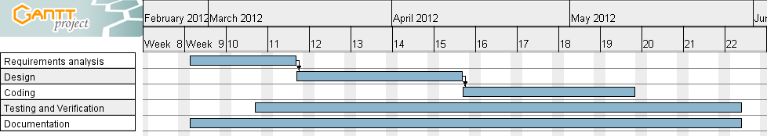
Schedule

